Slide 1



CATCH THE AI
AI GENERATED MEDIA DETECTION

Slide 2
Project Team
Romani Nasrat Shawqi .
Ahmed Mohamed Ali.
Zeyad Elsayed Abdel-Azim Yousif.
Sara Reda Moatamed.
Reham Moustafa Ali.
Rawan Abdel-Aziz Ahmed.
Abdallah Mohammed Abdel-monnem.
Mohannad Ayman salah.
Mohammed Abdallah Abdel-salam.
Under Supervision :
Dr. Eman Abdel-Latef .
Eng. Sahar Mohamed.

Slide 3




Agenda
Problem Statement.
Gap in scientific scene.
Methodology with implementation and evaluation.
Conclusion.

Slide 4

Problem Statement.
The rapid advancement of AI technologies, such as GANs and transformers, makes it increasingly difficult to distinguish between AI-generated and human-created content.
This creates opportunities for the spread of misinformation, erosion of trust, academic dishonesty, and cyberbullying.
As AI-generated media becomes more lifelike, robust detection systems are essential to maintain trust and transparency in online interactions.
Gap in scientific scene.

Slide 5


Existing Techniques.
Gap in scientific scene.
Multimodal Detection.
Real-time Detection.
Generalizability.
Explainability
Methodology with implementation and evaluation
Conclusion

Slide 6

Gap in scientific scene.
Methodology with implementation and evaluation
Utilizing advanced algorithms, the system identifies subtle manipulations indicative of AI generation. Three primary detection models form the core of this system and were worked on in parallel :
AI Image Generation Detection: Accurately identifies images created by artificial intelligence.
AI Text Generation Detection: Recognizes text authored by AI algorithms and distinguishes it from human-generated content.
AI-Generated Audio Detection: Identifies and differentiates between audio content generated by artificial intelligence and authentic human-recorded audio.
Then we started working on Building the system:
System Architecture.
Conclusion

Slide 7

Models Selection
Methodology with implementation and evaluation
Audio Model
Text Model
Image Model

Slide 8
Methodology with implementation and evaluation
Spectral Analysis
Existing Techniques
Voice Characteristics Analysis
Machine Learning Models

Slide 9
Methodology with implementation and evaluation
Audio Models

Slide 10
Methodology with implementation and evaluation
Audio Models
Initial Model Development
Data Collection
Feature Engineering
Model Architecture

Slide 11
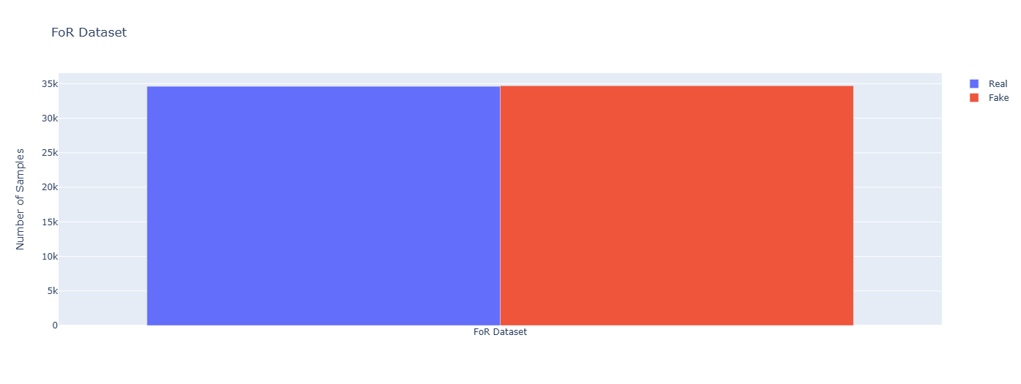
Methodology with implementation and evaluation
Audio Detector
Initial Model Development:
Data Collection:
The Fake-or-Real (FoR) dataset was utilized for the initial phase of this project.
The dataset contains over 195,000 utterances, including both human and computer-generated speech.

Slide 12
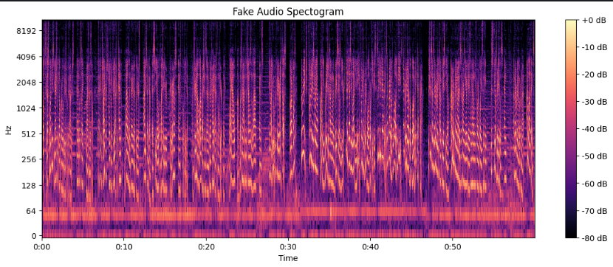
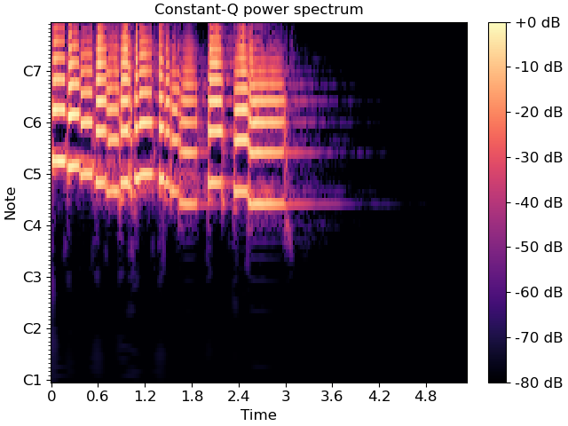
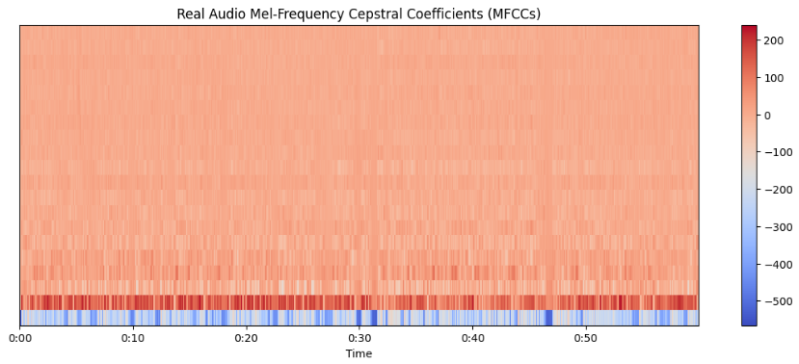
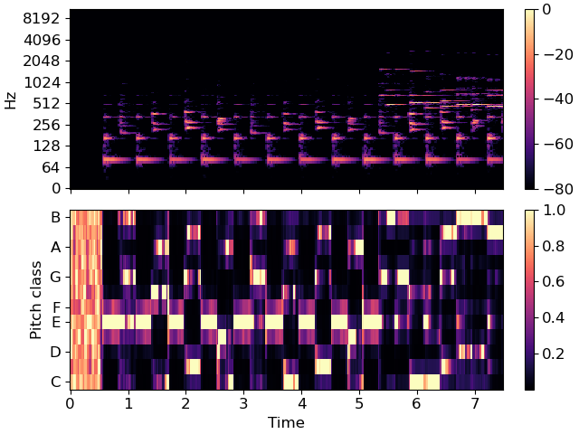
Methodology with implementation and evaluation
Audio Detector
Initial Model Development:
Feature Engineering:
In the feature engineering step, four key audio features were extracted from the dataset:
Mel-spectrogram CQT(Constant-Q Transform)
MFCC(Mel-Frequency Cepstral Coefficients)
Chroma

Slide 13
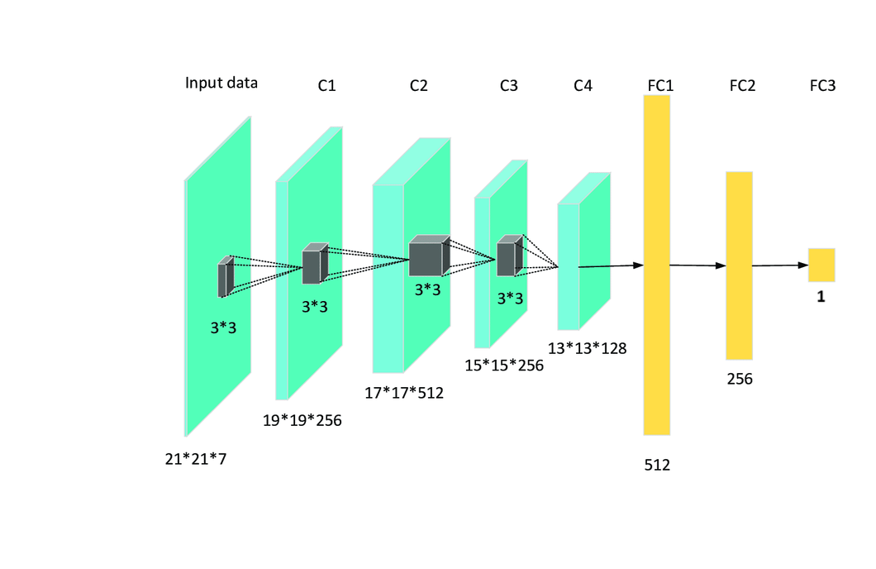
Methodology with implementation and evaluation
Audio Detector
Initial Model Development:
These features were then represented as images to serve as input for the convolutional neural network (CNN).

Slide 14
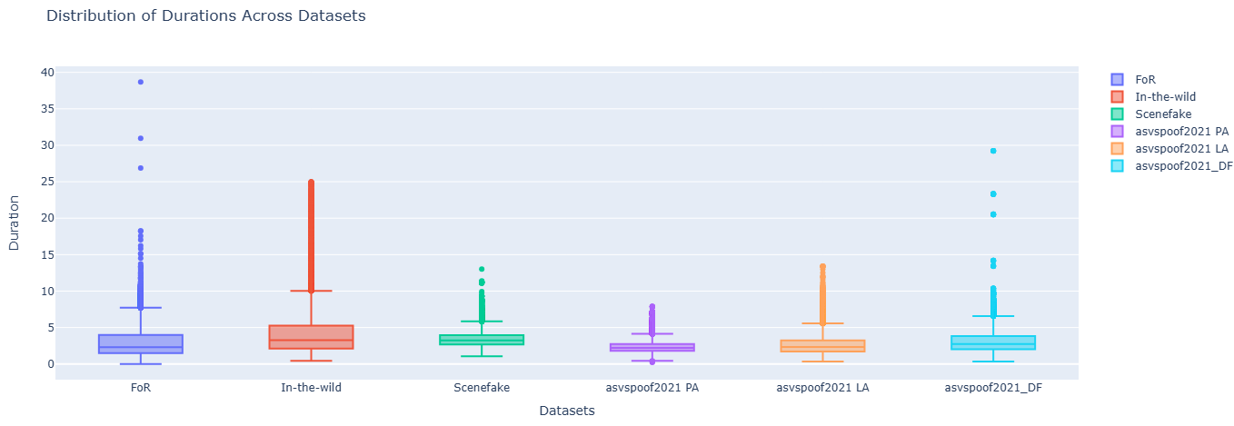
Methodology with implementation and evaluation
Audio Detector
Initial Model Development:
These features were then represented as images to serve as input for the convolutional neural network (CNN).

Slide 15
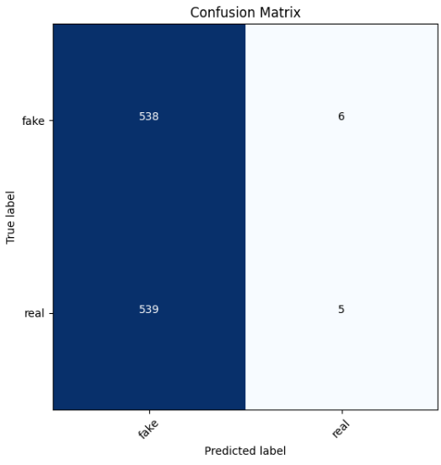
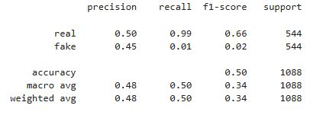
Methodology with implementation and evaluation
Audio Detector
Initial Model Development:
Model Architecture:
A custom CNN model with 4 hidden layers was designed for this stage. The CNN was chosen for its ability to effectively process and extract features from image representations of audio signals.

Slide 16
Methodology with implementation and evaluation
Audio Models
Initial Model Development
Utilizing Pre-trained Models
Utilizing Pre-trained Models:
Data Collection
Feature Engineering
Model Architecture
Data Collection
Model Architecture

Slide 17
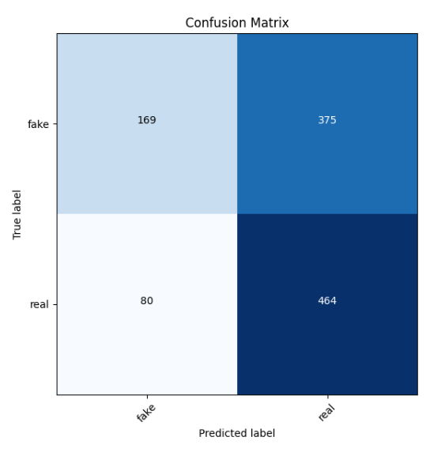
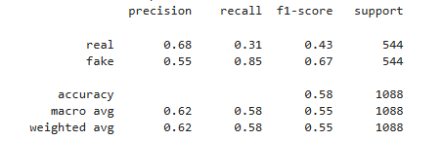
Initial Model Development:
Methodology with implementation and evaluation
Audio Detector
Utilizing Pre-trained Models:
Data Collection and Feature Engineering:
The same FoR dataset and feature extraction techniques were used in this stage to maintain consistency and ensure comparability of results.
Model Architecture :
VGG-16: A deep convolutional network known for its performance in image classification tasks.

Slide 18
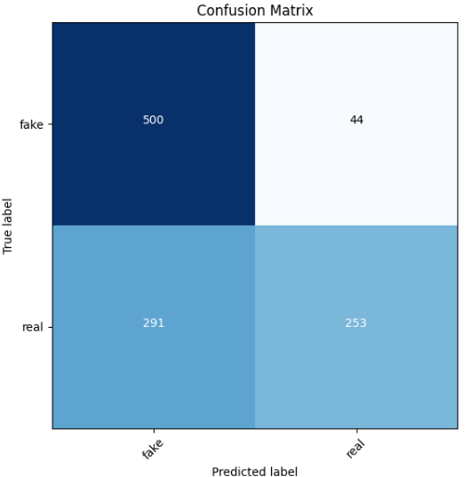
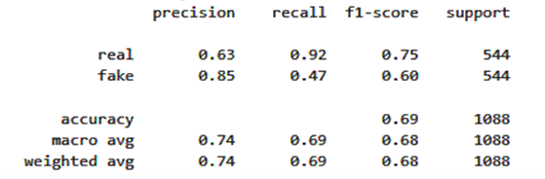
Initial Model Development:
Methodology with implementation and evaluation
Audio Detector
Utilizing Pre-trained Models:
Model Architecture :
MobileNet: A lightweight and efficient model designed for mobile and embedded vision applications.

Slide 19
Methodology with implementation and evaluation
First Phase
Audio Models
Initial Model Development
Advanced Techniques
Utilizing Pre-trained Models
Advanced Techniques:
Data Collection
Feature Engineering
Model Architecture
Data Collection
Model Architecture
Data Collection
Model Architecture

Slide 20
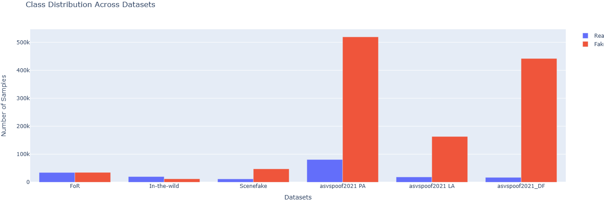
Utilizing Pre-trained Models:
Methodology with implementation and evaluation
Audio Detector
Advanced Techniques:
First Phase
Data Collection :
To enhance the model’s generalization capability, four additional datasets were incorporated:
SceneFake.
In The Wild.
ASVspoof 2019.
ASVspoof 2021.

Slide 21
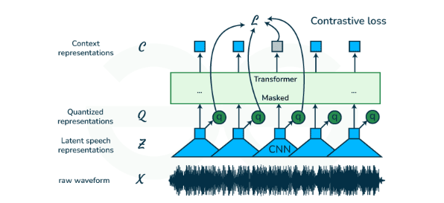
Utilizing Pre-trained Models:
Methodology with implementation and evaluation
Audio Detector
Advanced Techniques:
Second Phase
First Phase
Model Architecture :
The Wav2Vec2.0 model was chosen for its state-of-the-art performance in speech recognition tasks. This model uses a large amount of unlabeled data to learn high-quality speech representations.

Slide 22
First Phase
Utilizing Pre-trained Models:
Methodology with implementation and evaluation
Audio Detector
Advanced Techniques:
Third Phase
Second Phase
Training:
The model was trained on a combination of three datasets (FoR, SceneFake, and In The Wild) simultaneously to further improve generalization.
Results:
Training Accuracy: 99%
Validation Accuracy: 99%
Testing Accuracy: 99%
Although the combined training resulted in high accuracy, the model exhibited poor generalization when tested on entirely new and unseen data, indicating overfitting to the combined dataset.

Slide 23
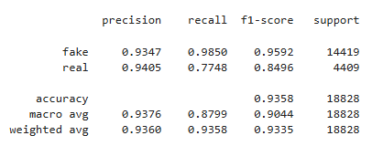
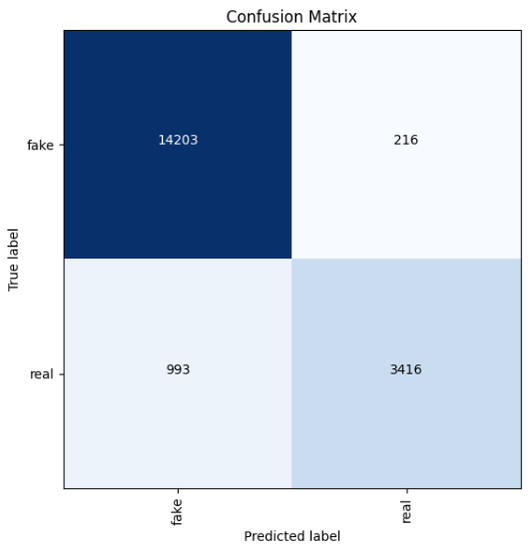
First Phase
Utilizing Pre-trained Models:
Second Phase
Methodology with implementation and evaluation
Audio Detector
Advanced Techniques:
Third Phase
Training:
To address the overfitting issue, the model was trained on the Logical Access (LA) and Physical Access (PA) data from the ASVspoof 2021 dataset, focusing on different types of spoofing attacks.
Results :
ASVspoof 2021 DF Testing

Slide 24
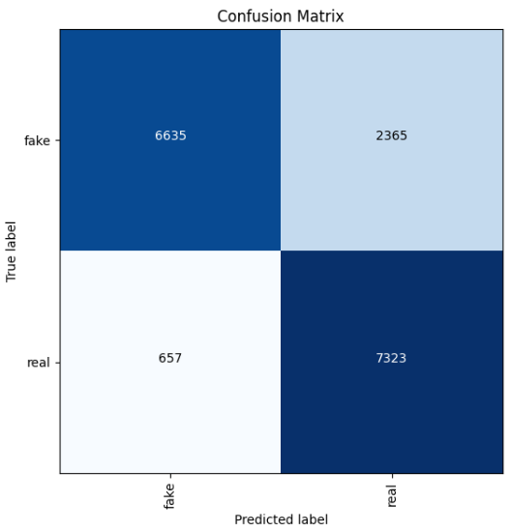
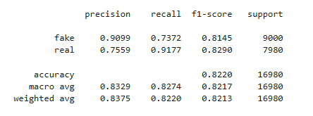
First Phase
Utilizing Pre-trained Models:
Methodology with implementation and evaluation
Audio Detector
Advanced Techniques:
Third Phase
Results :
ASVspoof 2019 Testing

Slide 25
First Phase
Utilizing Pre-trained Models:
Methodology with implementation and evaluation
Audio Detector
Advanced Techniques:
Third Phase
Metrics | Precision | Recall | F1-Score | Accuracy
Custom CNN | 0.48 | 0.50 | 0.34 | 0.50
MobileNet | 0.74 | 0.69 | 0.68 | 0.69
VGG16 | 0.62 | 0.58 | 0.55 | 0.58
Wav2Vec2.0 | 0.93 | 0.93 | 0.90 | 0.93

Slide 26
Models Selection
Methodology with implementation and evaluation
Audio Model
Text Model
Image Model
26

Slide 27
Methodology with implementation and evaluation
Stylometry
Existing Techniques
Contextual Analysis
Machine Learning Classifiers

Slide 28
Methodology with implementation and evaluation
Text Models

Slide 29
Methodology with implementation and evaluation
Text Models
Build Model from scratch
Data acquisition.
Data preprocessing.
Model Architecture .

Slide 30
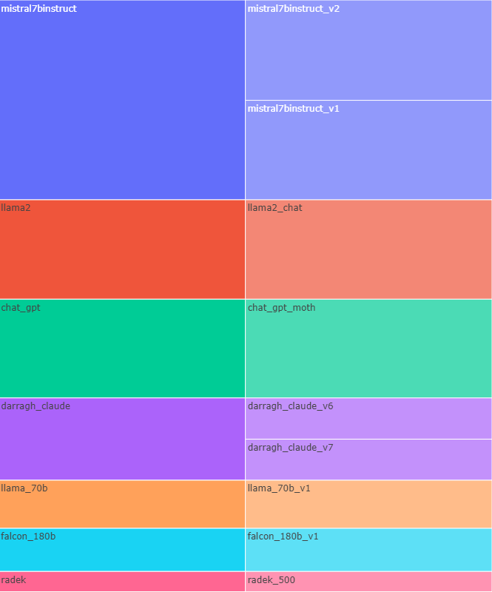
First Phase
Utilizing Pre-trained Models:
Methodology with implementation and evaluation
Text Detector
Build Model from scratch:
Data acquisition:
Data was collected from HuggingFace and Kaggle :
LLM - Detect AI Generated Text
DAIGT | Catch The AI

Slide 31
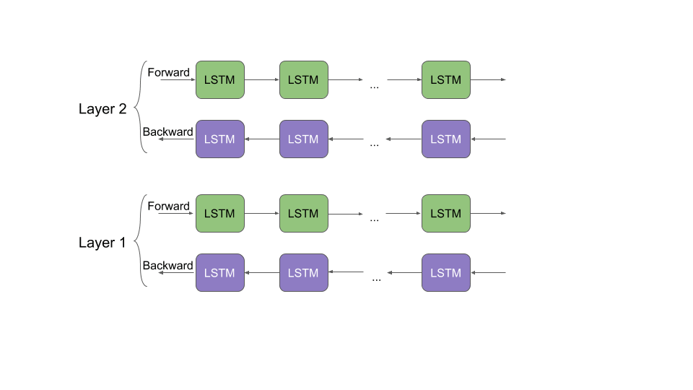
First Phase
Utilizing Pre-trained Models:
Methodology with implementation and evaluation
Text Detector
Build Model from scratch:
Data preprocessing:
Cleaning :
URLs
hashtags and special characters
multiple spaces to a single space.
lowercase
Tokenization:
Use tokenizer from Keras and ELMo to Embedding .
Use pre-trained BERT Tokenizer and Embedding from Transformer library.
Length sequence 512.

Slide 32
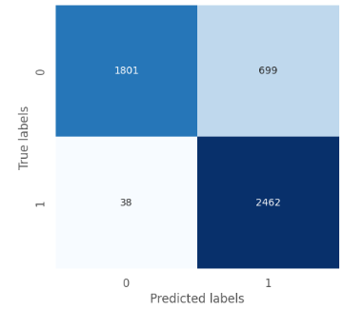
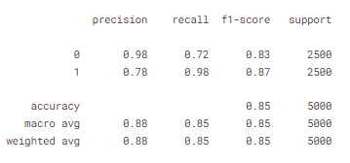
First Phase
Utilizing Pre-trained Models:
Methodology with implementation and evaluation
Text Detector
Build Model from scratch:
Model Architecture :
Use Bi-LSTM to allows the model to capture context and understand sentence from both directions.
use convolutional layer that operates on sequential data with one spatial dimension to increase complexity.

Slide 33
Methodology with implementation and evaluation
Text Models
Go to Pre-train Models :
Build Model from scratch
Go to Pre-train Models
Data acquisition.
Data preprocessing.
Model Architecture .
Data Preparation.
Model Architecture.
Mistral-7B.
BERT.

Slide 34
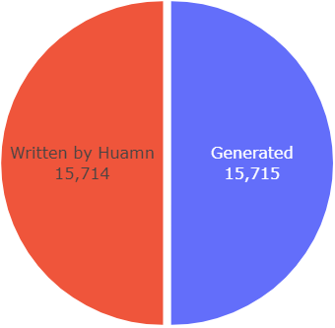
Build Model from scratch:
Methodology with implementation and evaluation
Text Detector
Go to Pre-train Models :
Data Preparation:
We only used the data collected from Kaggle, which was about 32,462 data.
We used the data as it is, without cleaning .
Model Architecture:
Mistral 7B is a robust and efficient model for classification tasks, offering a compelling combination of performance, adaptability, and cost-effectiveness. Its ability to handle complex text understanding .

Slide 35
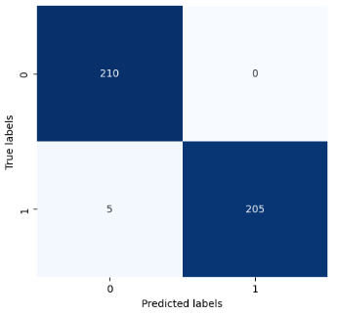
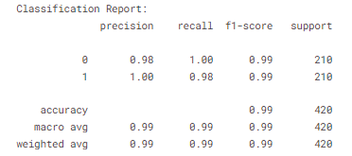
Build Model from scratch:
Methodology with implementation and evaluation
Text Detector
Go to Pre-train Models :
Challenges:
Model Size:
Memory Consumption.
Storage Requirements
Computational Time:
Training Time.
Inference Time.

Slide 36
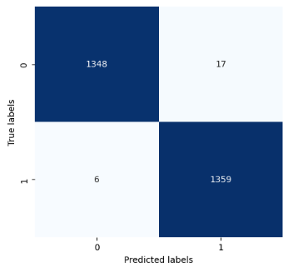
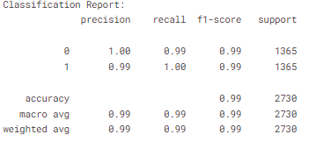
Build Model from scratch:
Methodology with implementation and evaluation
Text Detector
Go to Pre-train Models :
Model Architecture:
BERT is specialized for tasks requiring deep contextual understanding and has set benchmarks in many NLP tasks due to its bidirectional approach.
Size: Original BERT comes in different sizes, such as BERT-Base (110 million parameters)

Slide 37
Methodology with implementation and evaluation
Text Models
Final model:
Build Model from scratch
Final model
Go to Pre-train Models
Data acquisition.
Data preprocessing.
Model Architecture .
Model Architecture.
RoBERTa.
DeBERTa.
Ensemble of Models.
Final architecture.
Data Preparation.
Model Architecture.
Mistral-7B.
BERT.

Slide 38

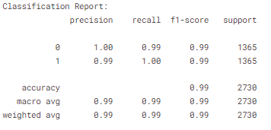
Go to Pre-train Models :
Methodology with implementation and evaluation
Text Detector
Final model:
Model Architecture:
RoBERTa Enhanced version of BERT with optimizations in training methods and datasets.

Slide 39

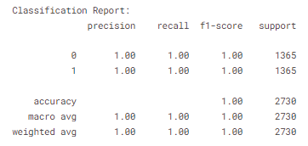
Go to Pre-train Models :
Methodology with implementation and evaluation
Text Detector
Final model:
Model Architecture:
DeBERTa Advanced model with architectural enhancements like disentangled attention and an enhanced mask decoder.

Slide 40
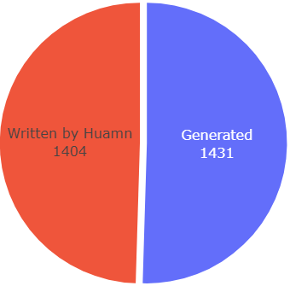
Go to Pre-train Models :
Methodology with implementation and evaluation
Text Detector
Final model:
Ensemble of RoBERTa and DeBERTa:
Averaging Probabilities.
Feed-forward Model.
Some data is collected by us and Kaggle for use in human-evaluation

Slide 41
Go to Pre-train Models :
Methodology with implementation and evaluation
Text Detector
Final model:
Model | Accuracy | Precision | Recall | F1-score | ROC-AUC
BERT | 0.994356 | 0.990978 | 0.997904 | 0.994429 | 0.994322
RoBERTa | 0.995767 | 0.998406 | 0.997904 | 0.995816 | 0.995747
DistilBERT | 0.992240 | 0.995081 | 0.989518 | 0.992292 | 0.992266
DeBERTa | 0.998942 | 0.997908 | 1.000000 | 0.998953 | 0.998932
Averaging Probabilities (RoBERTa -DeBERTa) | 0.983069 | 0.998558 | 0.967855 | 0.982967 | 0.983215
Feed-forward Model (RoBERTa -DeBERTa) | 0.999647 | 0.999302 | 1.000000 | 0.999651 | 0.999644

Slide 42
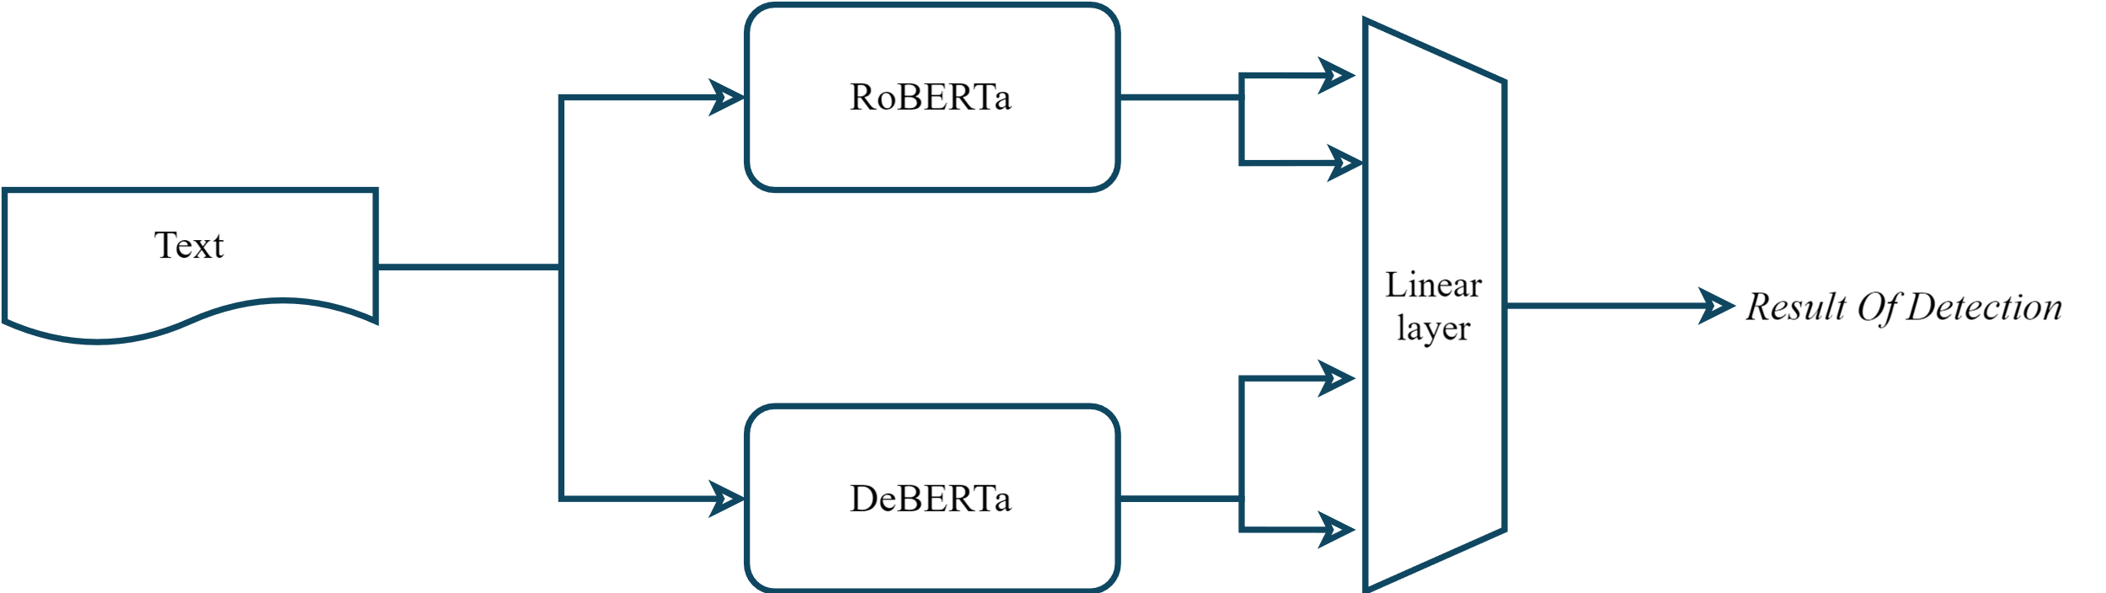
Go to Pre-train Models :
Methodology with implementation and evaluation
Text Detector
Final model:

Slide 43

Models Selection
Methodology with implementation and evaluation
Audio Model
Text Model
Image Model

Slide 44
Methodology with implementation and evaluation
Forensic Analysis
Existing Techniques
GAN Fingerprints
Deep Learning Models

Slide 45
Methodology with implementation and evaluation
Image Models

Slide 46
Methodology with implementation and evaluation
Image Models
Build Model from scratch using CNN
Data acquisition.
Model Architecture .

Slide 47
Methodology with implementation and evaluation
Image Models
Build Model from scratch using CNN
Data acquisition.
Model Architecture .

Slide 48
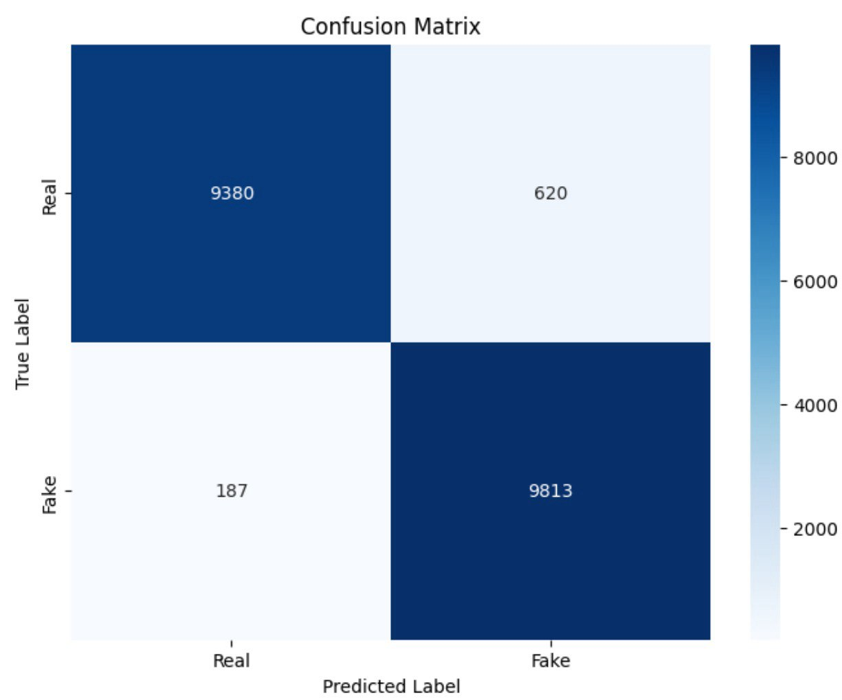
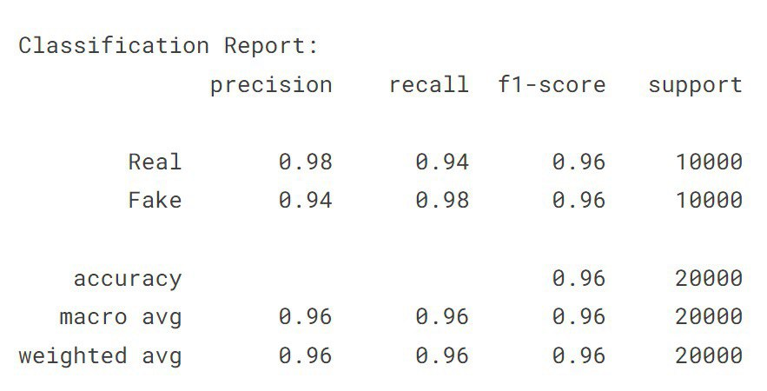
Go to Pre-train Models :
Methodology with implementation and evaluation
Image Detector
Build Model :
Data acquisition:
The Data was 140 thousand images, split evenly having fake images from StyleGAN 1 created by nvidia, and flickr images collected by nvidia to train its GAN models.
Model Architecture:
model using 4 CNN [32,64,128,128] Layers and 1 Feed forward layer [128 ]
Data Augmentation:

Slide 49
Methodology with implementation and evaluation
Image Models
Build Model from scratch using CNN
Data Preparation
Data acquisition.
Model Architecture .
Data acquisition.
Model Architecture

Slide 50
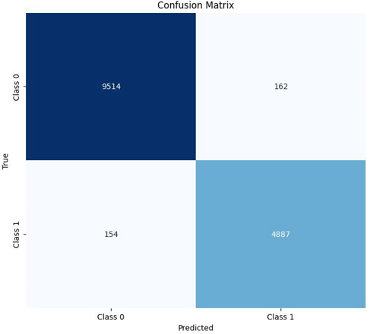
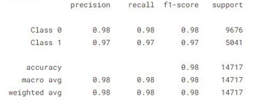
Go to Pre-train Models :
Methodology with implementation and evaluation
Image Detector
Data Preparation:
Testing on Biased Data:
Data Augmentation:

Slide 51
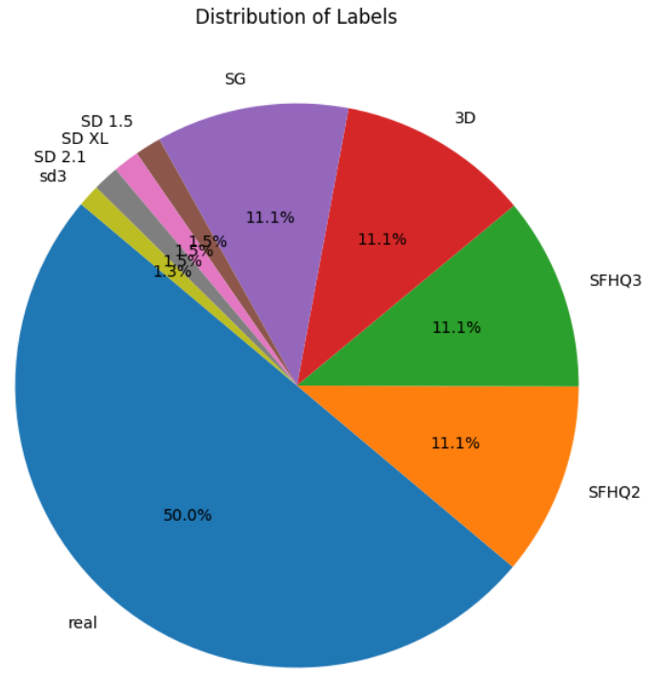
Build Model :
Go to Pre-train Models :
Methodology with implementation and evaluation
Image Detector
Data Preparation:
It had generalization problems .
The data have various image size ranging between 512 – 1024.
200K images
Train |  | Validate |  | Test
Real: 70 k | Fake: 70 k | Real: 15 k | Fake: 15 k | Real: 15 k | Fake: 15 k
70k Flickr | 3k SD V2.1 | 15 k CelebA HQ | 3k SDXL 1.0 | 15 k CelebA HQ | 2536 SD 1.4
 | 3k SD V1.5 |  | 3k SG1 |  | 3116 SG1
 | 16k SG1 |  | 3k EG3D |  | 3116 EG3D
 | 16k EG3d |  | 16k S SG2 |  | 3116 S SG2
 | 16k S SG2 |  | 16k S SD1.4 |  | 3116 S SD1.4
 | 16k S SD1.4
70 % Data |  | 15 % Data |  | 15 % Data

Slide 52
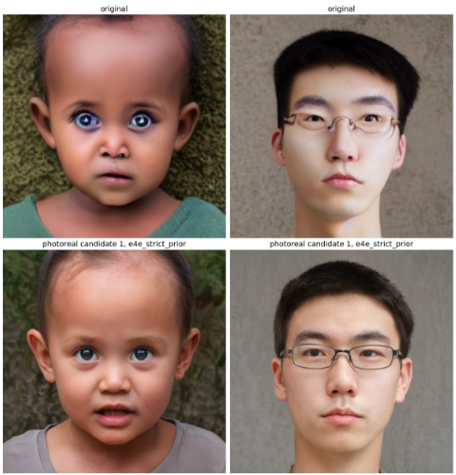

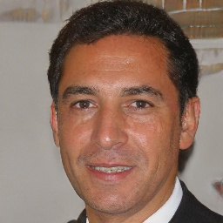
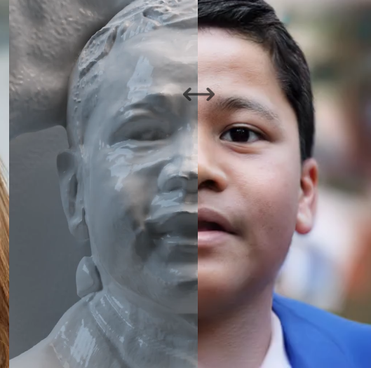
Build Model :
Go to Pre-train Models :
Methodology with implementation and evaluation
Image Detector
Data Preparation:
Fake Data
Style GAN
Synthetic Data
Stable Diffusion
SG
3D GAN
Use Pre-trained Models:

Slide 53
Methodology with implementation and evaluation
Image Models
Build Model from scratch using CNN
Use Pre-trained Models
Data Preparation
Data acquisition.
Model Architecture .
Model Architecture.
Data acquisition.
Model Architecture

Slide 54
Build Model :
Data Augmentation:
Go to Pre-train Models :
Methodology with implementation and evaluation
Image Detector
Use Pre-trained Models:
To achieve robustness and generalization we decided to use state of the art pre trained models and vision transformers.
Models Architecture:
Xception : we choose this model due to its efficient calculations using the depth wise operations to reduce number of parameters, and number of operations
Efficient Net: Allows versatility as it dynamically Scales its own network width, depth, and resolution, the difference between versions is in the resolution.
ViT: the first vision transformer to appear, its attention mechanism allows for robust detection of small details.

Slide 55
Build Model :
Data Augmentation:
Go to Pre-train Models :
Methodology with implementation and evaluation
Image Detector
Use Pre-trained Models:
Metrics | Accuracy | Precision | Recall | F1-Score
EfficientNetB2 | 94.3% | 94.3% | 94.2% | 94.2%
EfficientNetB6 | 99.5% | 99.5% | 99.5% | 99.5%
ViT 224 | 96.7% | 96.7% | 96.6% | 96.6%
ViT 384 | 98.8% | 98.8% | 98.8% | 98.8%
Xception | 97% | 98% | 97% | 98%

Slide 56
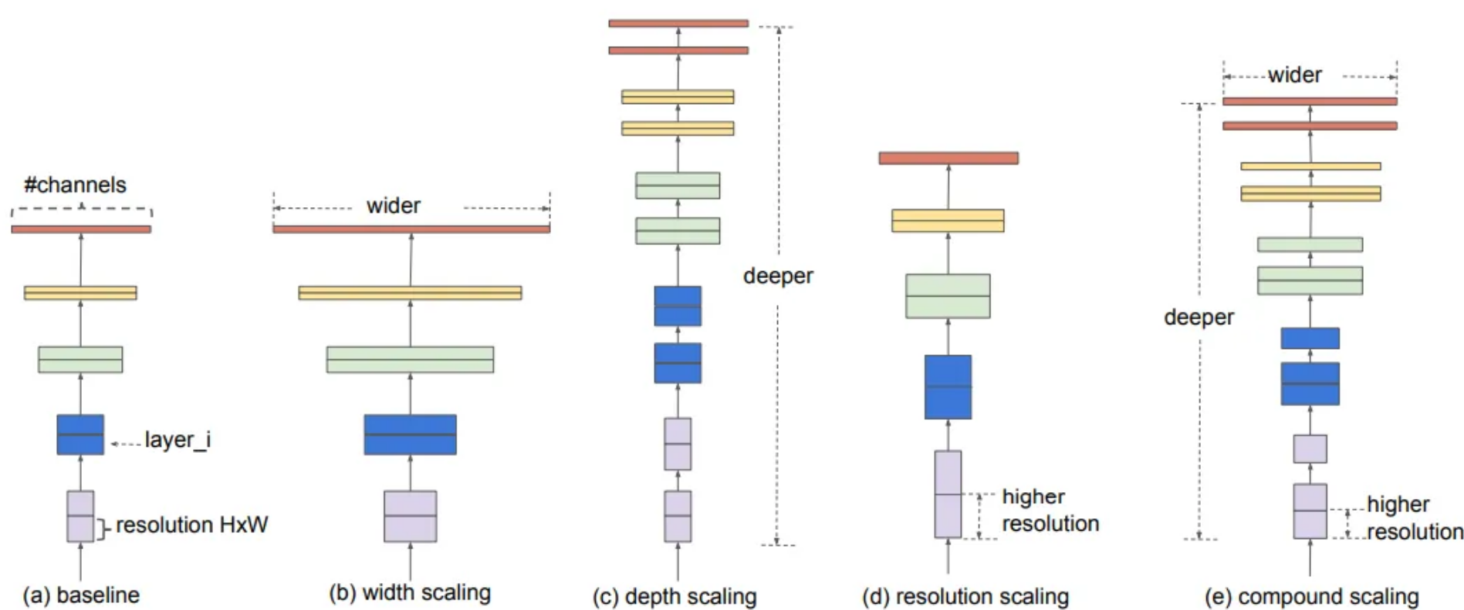
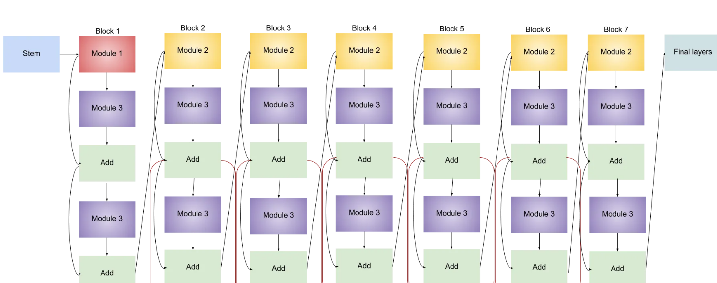
Methodology with implementation and evaluation
Model Selection: Efficient Net B6
Highest results.
Dynamic Scaling.
Allows Future training on large scale data.
56

Slide 57

System Architecture
Methodology with implementation and evaluation
Overview of System.
Model or Pattern.
Client (Frontend).
Server (Backend).
57

Slide 58
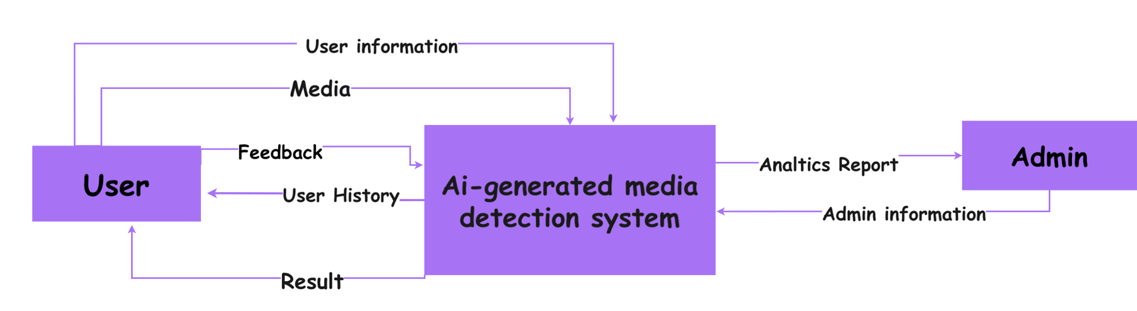
System Architecture
Methodology with implementation and evaluation
Overview of System
The AI-Generated Media Detection project adopts a modular architecture, separating frontend and backend components to ensure scalability, maintainability, and flexibility.
This architecture facilitates independent development and deployment of each layer while promoting efficient communication through RESTful APIs.

Slide 59

System Architecture
Methodology with implementation and evaluation
Model or Pattern:
Client-Server Architecture with RESTful APIs.
Client (Frontend):
Responsibilities : Handles presentation logic and user interaction.
Communication :Communicates with the backend server via HTTP requests using RESTful APIs to fetch data, submit user actions (e.g., authentication, media detection requests), and display results.
Server (Backend):
Responsibilities: Implements business logic, manages data persistence, and integrates with external services.
APIs: Exposes RESTful APIs that the frontend consumes, handling requests for user authentication, media detection, user profile management, and other application functionalities.
Security: Implements JWT tokens for secure authentication and authorization, ensuring data integrity and privacy.
Conclusion

Slide 60
System Architecture
Methodology with implementation and evaluation
Conclusion
System built on the website that supports multimedia.
Gap in scientific scene.
Multimodal detection.
Generalized models.
Real-time Detection.

Slide 61

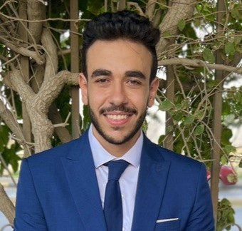



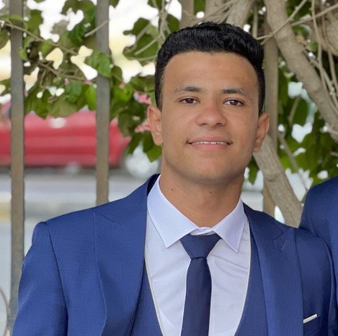



Catch the AI Team
Text
Image
LinkedIn
Audio
Mohannad
Zeyad
Romani
Abdallah
Mohammed
Ahmed
Rawan
Sara
Reham

Slide 62

Scan QR code to access website.

Slide 63
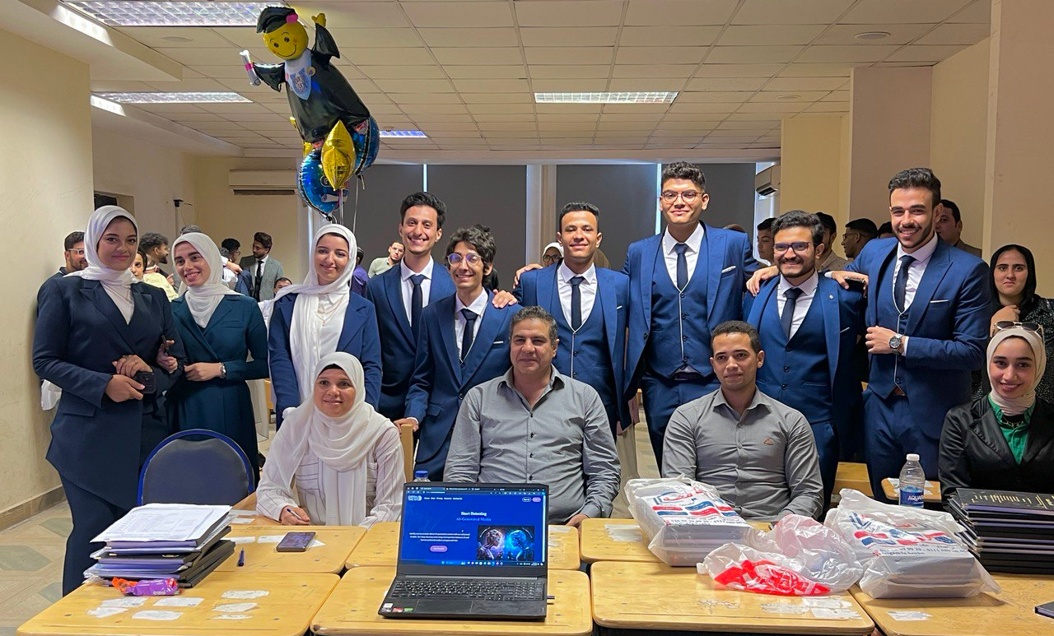
Thank you
Catch the AI Team
Under Supervision :
Dr. Eman Abdel-Latef .
Eng. Sahar Mohamed.

